Slide 1
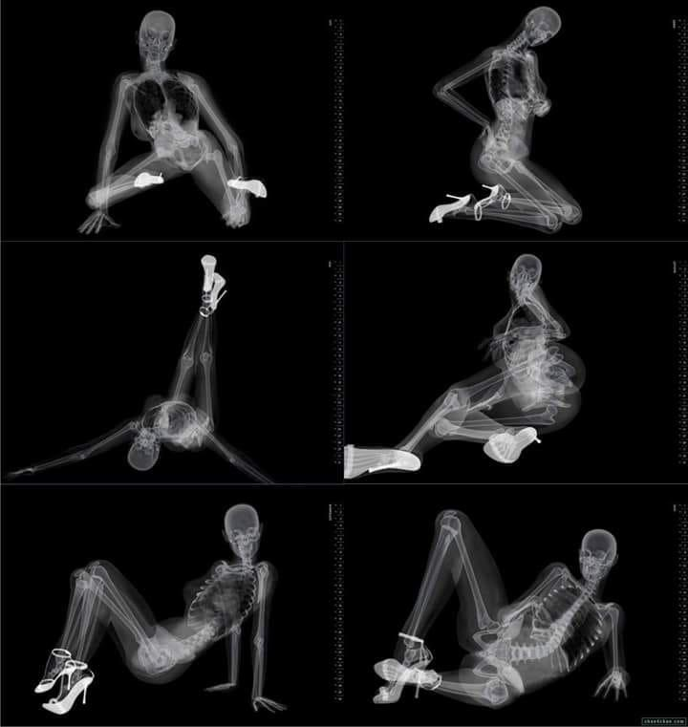
IMAGE SHARPENING USING HIGHPASS FILTERS
Image enhancement using High Frequency Emphasis filtering and Histogram Equalization in Python-OpenCV

Slide 2
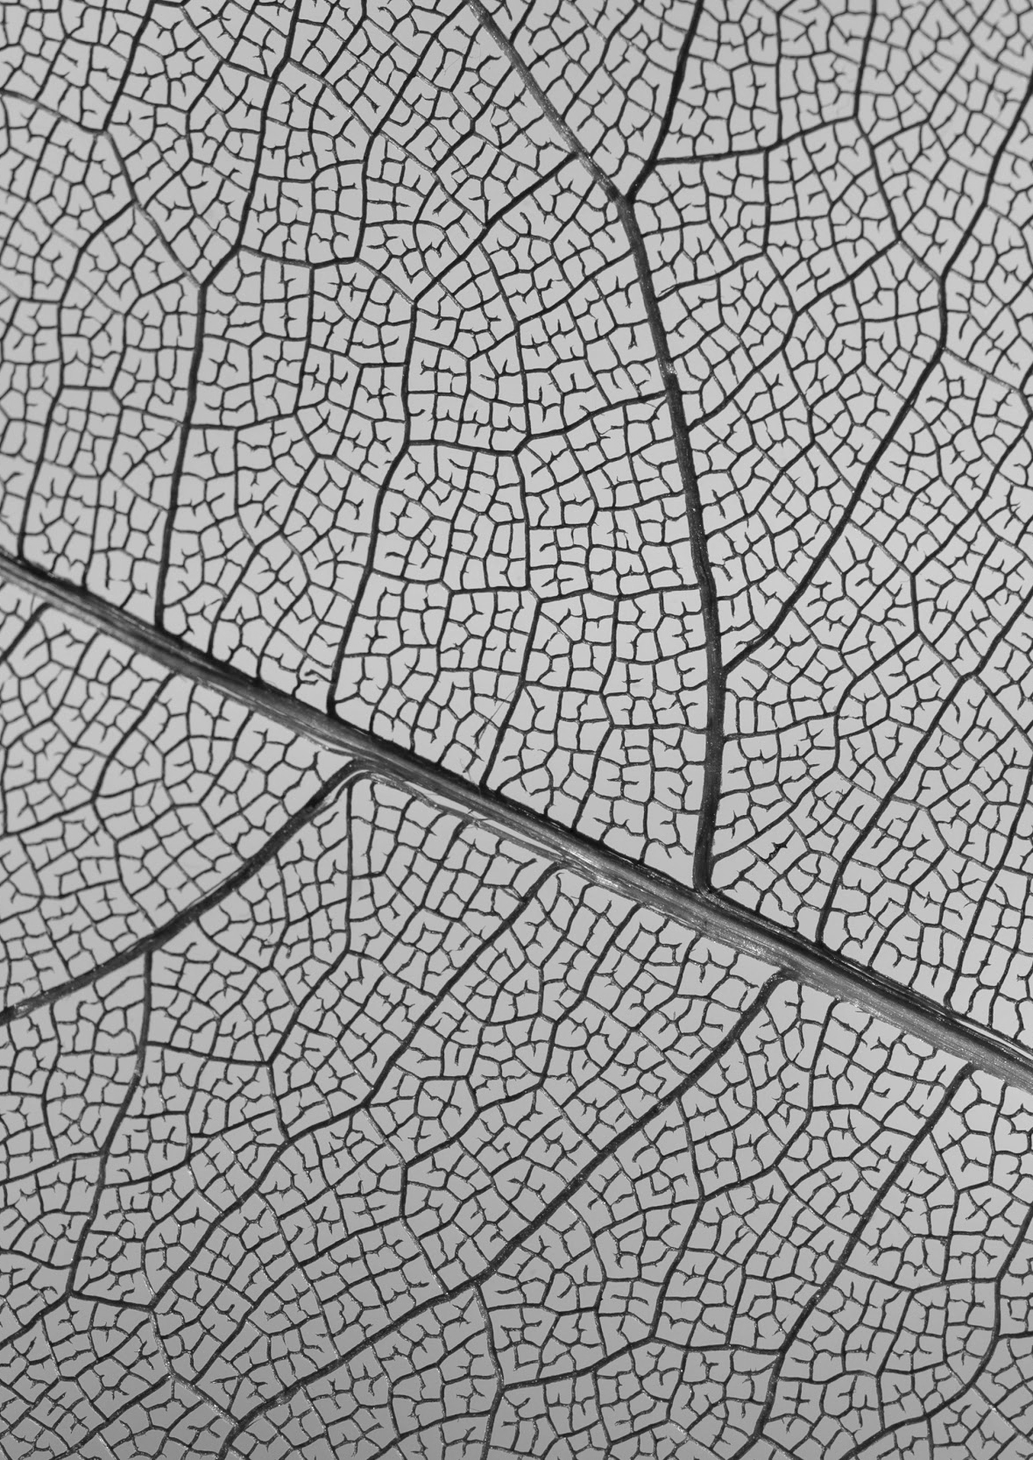
TABLE OF CONTENTS
01.
PROBLEM & SOLUTION
02.
HIGHPASS FILTERS
03.
THE PROCESS
04.
REFERENCES
Problems in sharpening the details of grayscale images
How it works
Image enhancement using high frequency emphasis filtering.

Slide 3
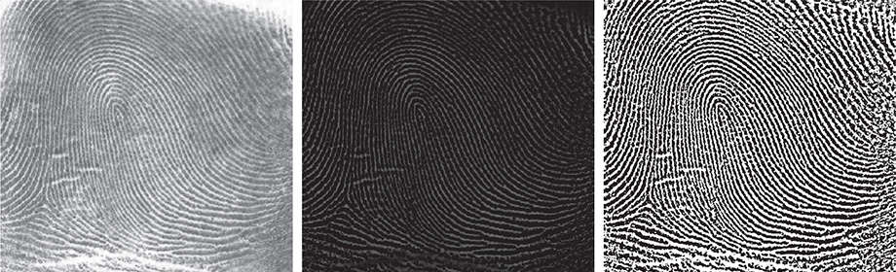
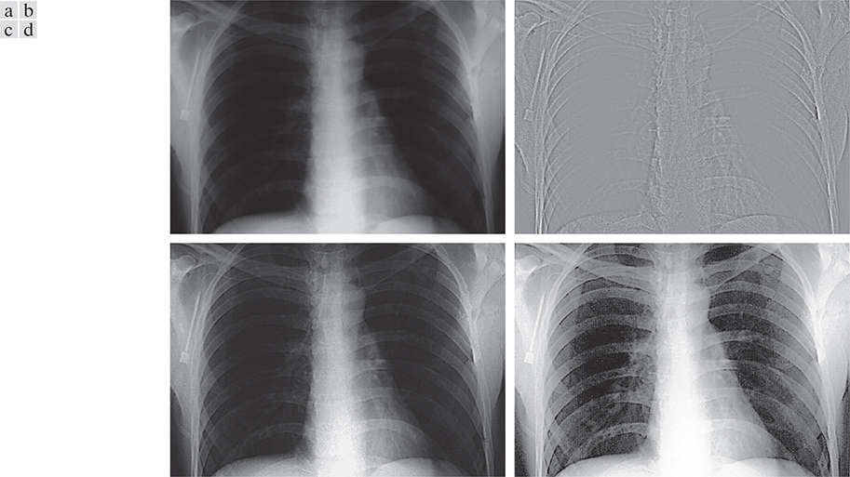
01
PROBLEM & SOLUTION
Given grayscale samples from astronomical images, X-ray images, magnetic resonance images need to be sharpened with high precision, highlighting patterns without losing other details.

Slide 4
UNDERSTANDING THE PROBLEM
THE OUTPUT IMAGES
FILTERING
HISTOGRAM EQUAZILATION
Increase detail on the patterns and eliminate noises
Helps in the sharpening of an image by emphasizing the edges
technique for maximizing the image contrast

Slide 5
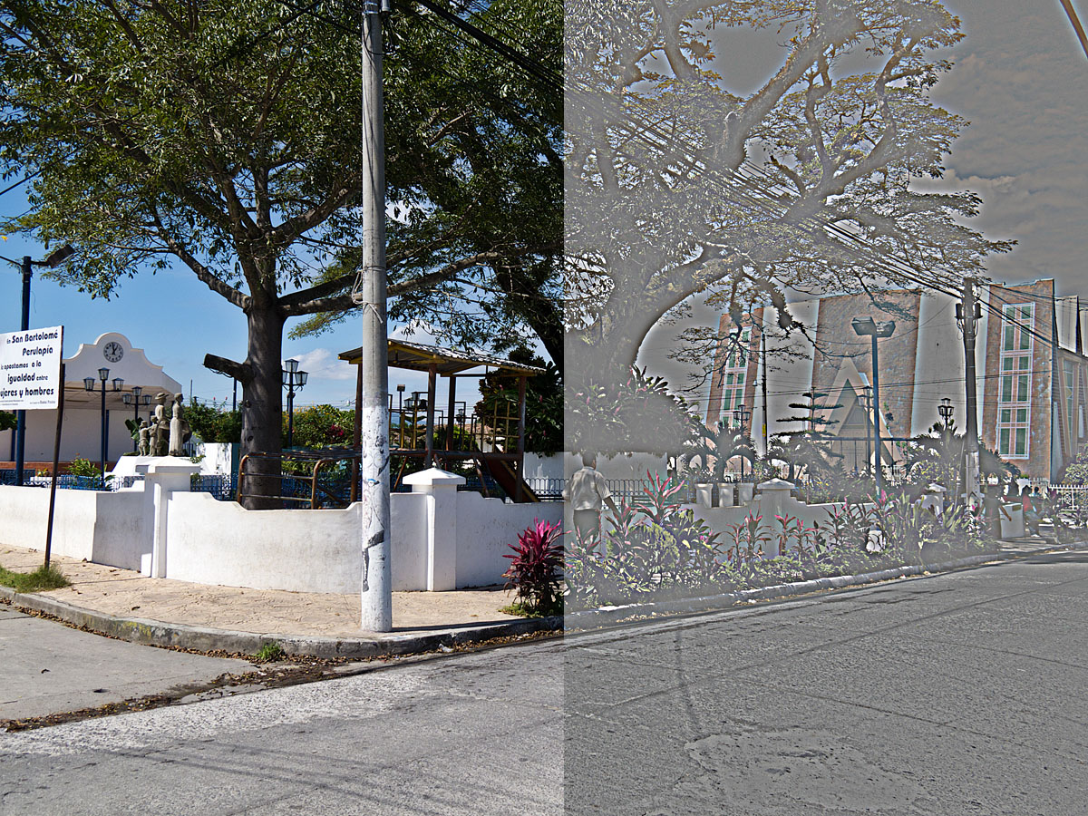
02
HIGHPASS FILTERS
Ideal, Gaussian, and Butterworth Highpass Filters From Lowpass Filters

Slide 6
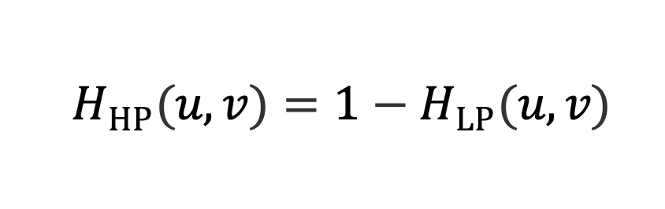
SUBTRACTING EQUATION
subtracting a lowpass filter transfer function from 1 yields the corresponding high pass filter transfer function in the frequency domain:

Slide 7
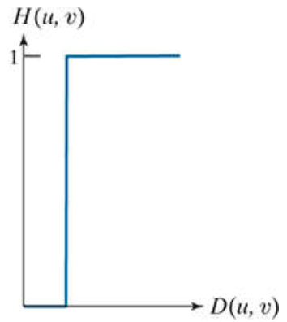
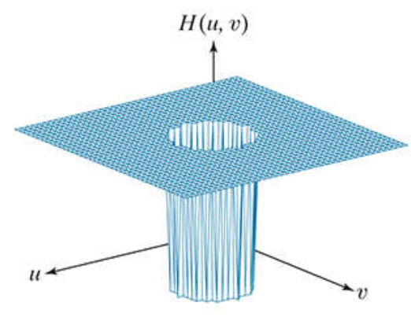
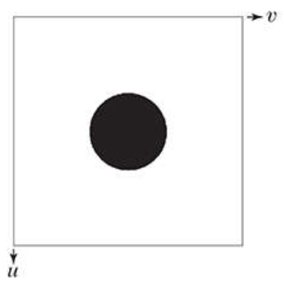
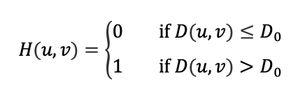
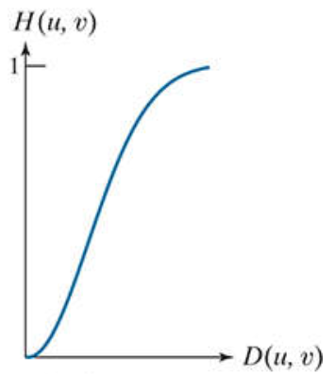
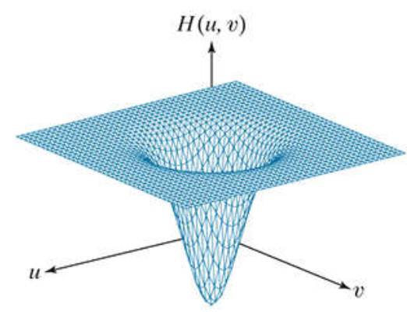
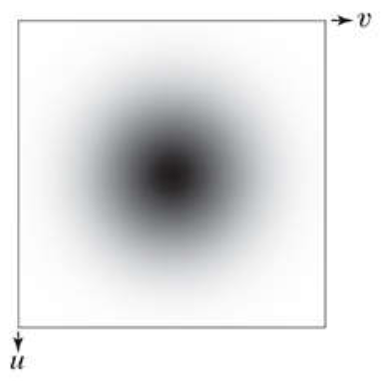
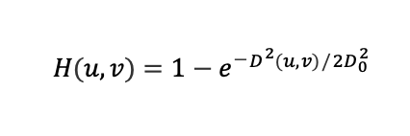
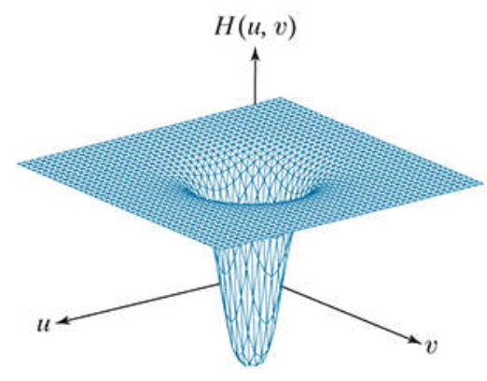
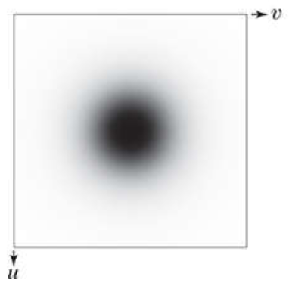
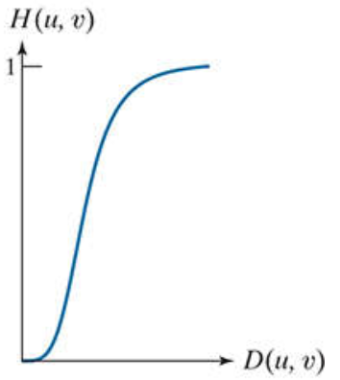
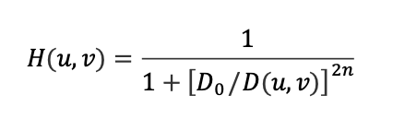
OUR SOLUTIONS
ideal highpass filter (IHPF)
Gaussian highpass filter (GHPF)
Butterworth highpass filter (BHPF)

Slide 8
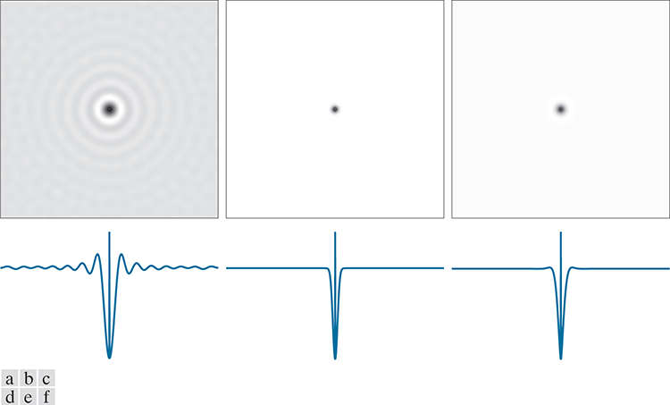
KERNEL RENDERING
(a)–(c): Ideal, Gaussian, and Butterworth highpass spatial filters obtained from IHPF, GHPF, and BHPF frequency-domain transfer functions. (The thin image borders are not part of the data.) (d)–(f): Horizontal intensity profiles through the centers of the kernels

Slide 9
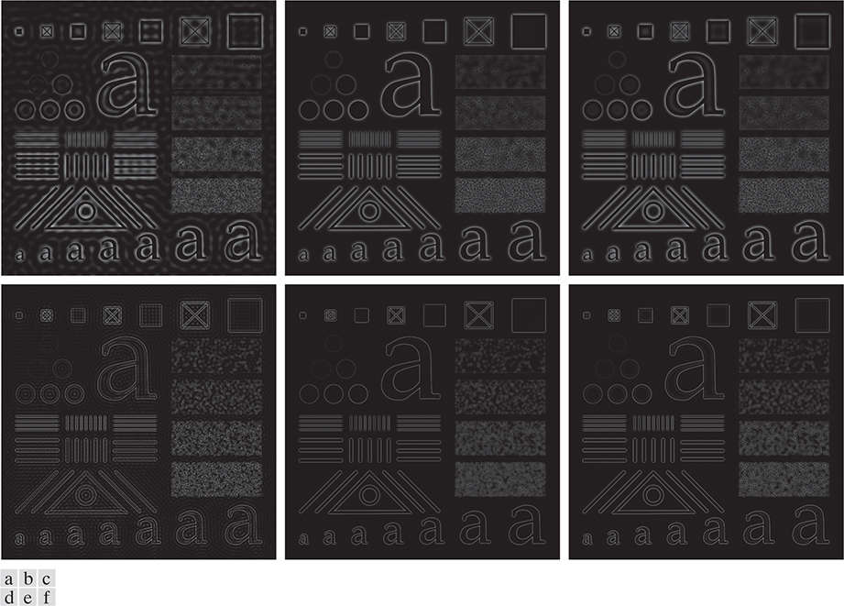
CHARACTER TEST PATTERN
(a)–(c): Ideal, Gaussian, and Butterworth highpass spatial filters obtained from IHPF, GHPF, and BHPF frequency-domain transfer functions. (The thin image borders are not part of the data.) (d)–(f): Horizontal intensity profiles through the centers of the kernels
(a)–(c): filtered with IHPF, GHPF, and BHPF transfer functions using = 60 in all cases ( = 2 for the BHPF). (d)–(f): Second row: Same sequence, but using = 160 .

Slide 10
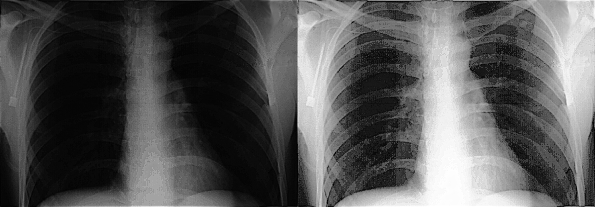
03
THE PROCESS
Image enhancement using high frequency emphasis filtering Python CV project.

Slide 11
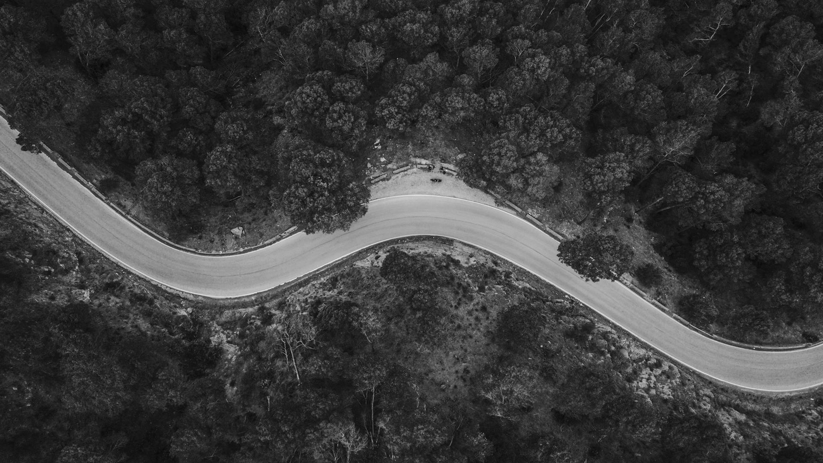
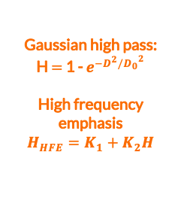

HIGH-FREQUENCY EMPHASIS FILTERING
Input image
Fourier transform
F(u,v)
Filter function
Gaussian high pass:
H $=$ 1 - $e^{−D^{2}/{D_{0}}^{2}}$
High frequency emphasis
$$H_{HFE}=K_{1}+K_{2}H$$
Final image
Inverse Fourier
Ready for histogram equalization
F*$H_{HFE}$

Slide 12

HISTOGRAM EQUALIZATION

Slide 13
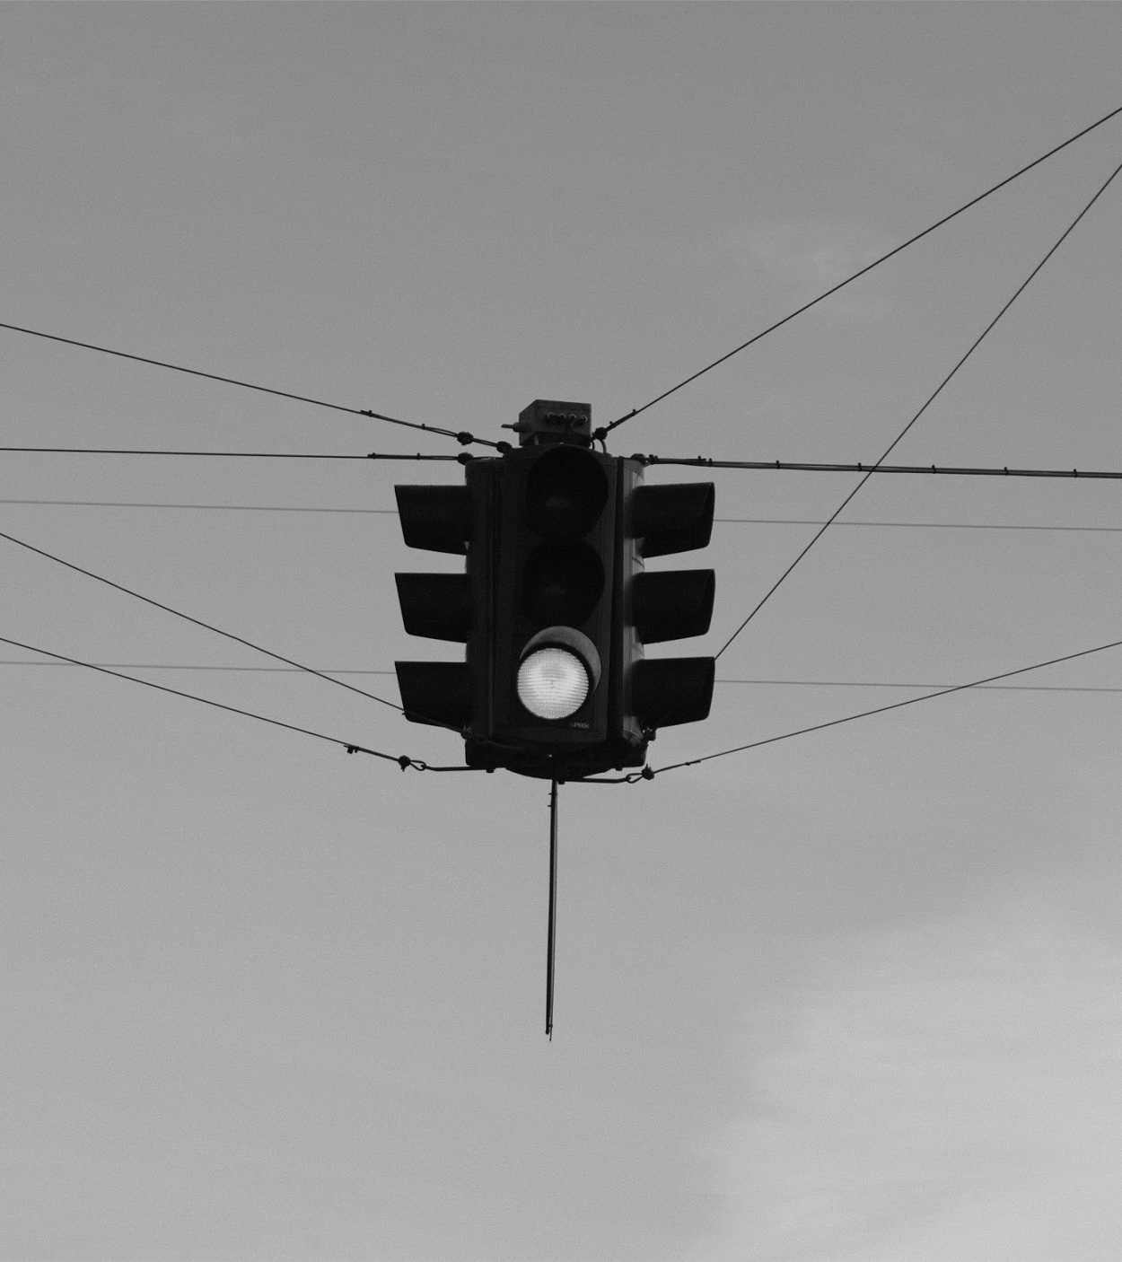
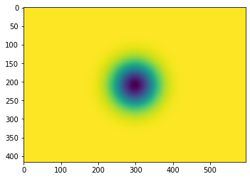
RESULTS
(a) A chest X-ray. (b) Result of filtering with a GHPF function. (c) Result of high-frequency-emphasis filtering using the same GHPF. (d) Result of performing histogram equalization on (c).
High Pass Gaussian Filter applied
Image Processing
High-frequency Emphasis

Slide 14
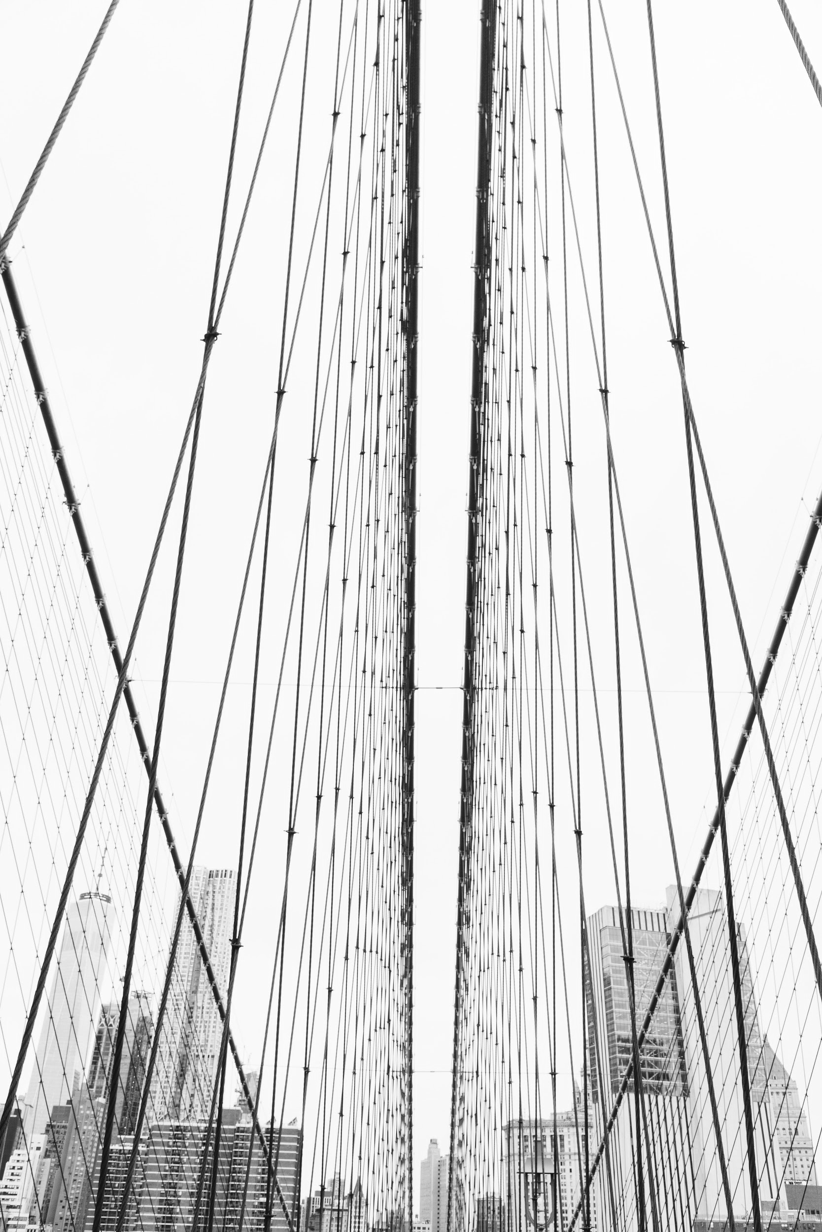
THANKS FOR WATCHING!
ANY QUESTION?
tientrung866@gmail.com
+84 971127195
Please keep this slide for attribution.

